Slide 1
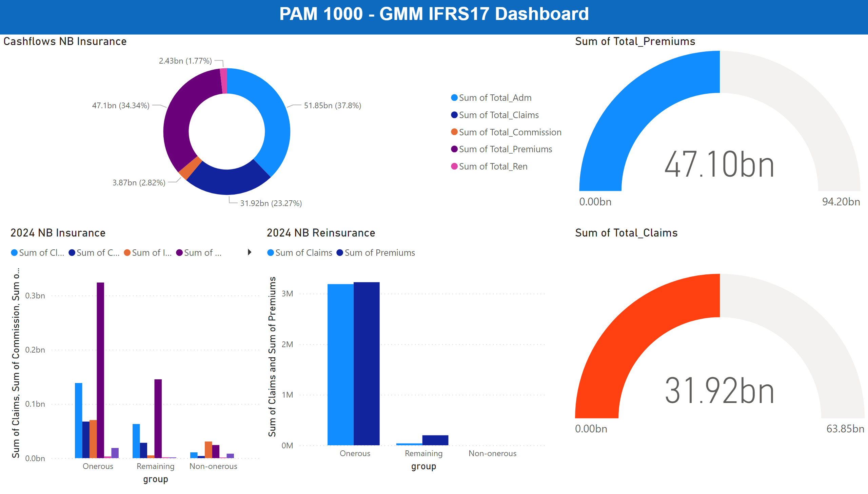
NB Insurance
Notes:
2024 NB Insurance
No alt text provided
textbox
No alt text provided
2024 NB Reinsurance
No alt text provided
Cashflows NB Insurance
No alt text provided
gauge
No alt text provided
gauge
No alt text provided

